Slide 1
I-66 OD Path analysis
Joseph Keogh : August 15, 2019

Slide 2
Problem Introduction
I – 66 Change
Combat Inbound and Outbound DC Traffic
Added HOV and Tolling lanes
Project Purpose
The main focus of the study will be to compare the relative volume of a roadway in the I-66 system has changed based on the existence of HOV and toll lanes, respective to the origin and destination of a trip.

Slide 3

Inrix Data
Third Party Data Compiler
Traffic Data from GPS Companies
Provides Product
Uses
This Photo by Unknown Author is licensed under CC BY-SA-NC

Slide 4
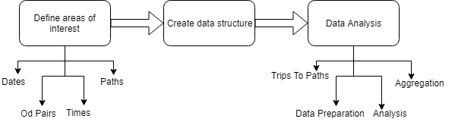
Methodology
Areas of Interest
Data Structure
Program
Post Processing

Slide 5
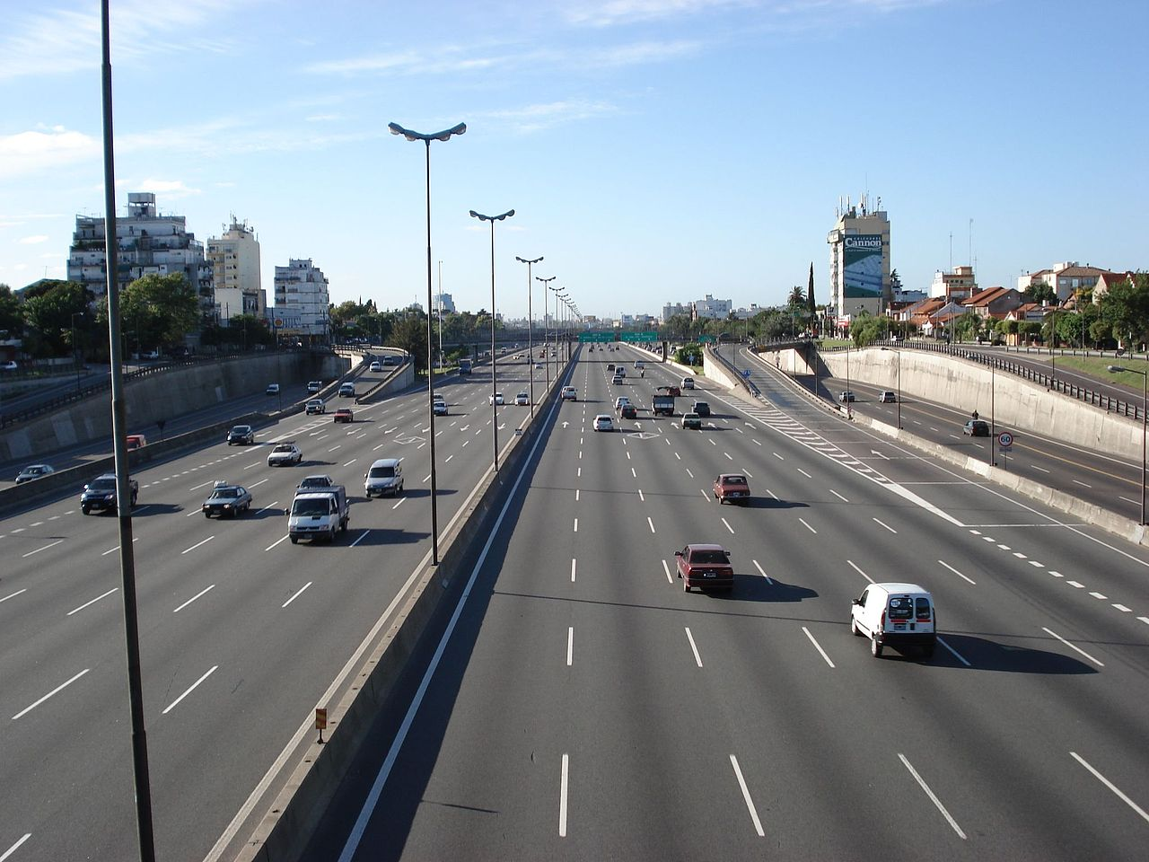

Areas of Interest
Dates
Origin and Destination Pairs
Times
Paths
This Photo by Unknown Author is licensed under CC BY-SA
This Photo by Unknown Author is licensed under CC BY-SA

Slide 6
Dates of Interest
Independent Variable
Existence of HOV and Tolling Lanes
Compare same dates from year to year
This Photo by Unknown Author is licensed under CC BY-SA

Slide 7
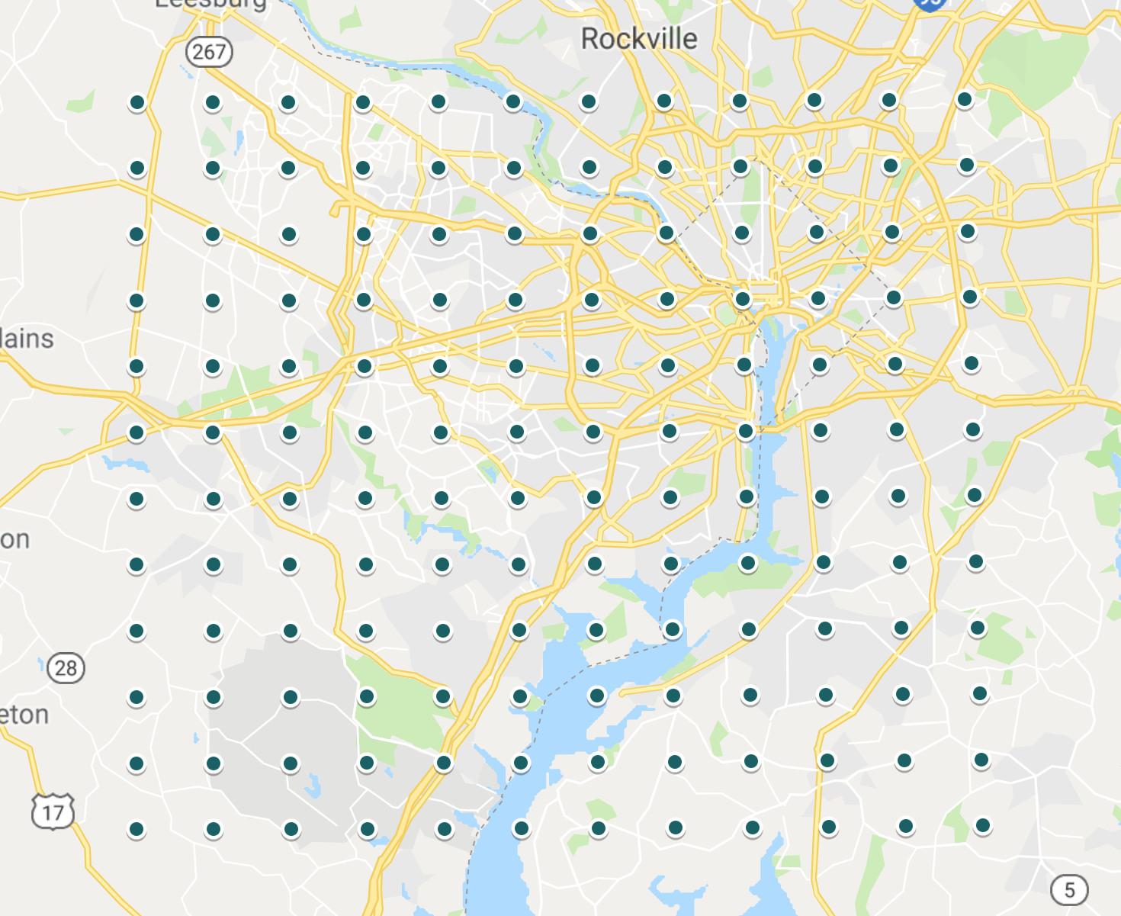
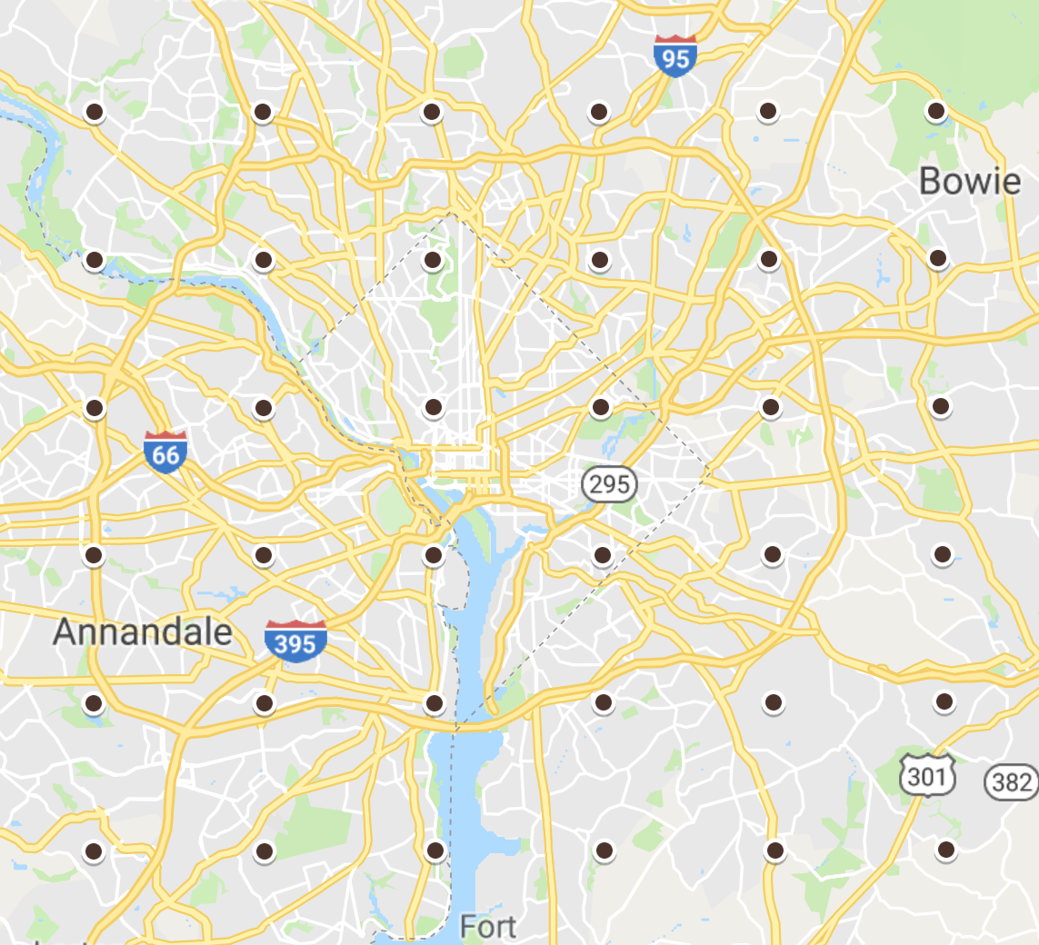
Origin and Destination Pairs
Grid Oriented
NOVA
DC

Slide 8
NOVA Grid

Slide 9
DC Grid

Slide 10
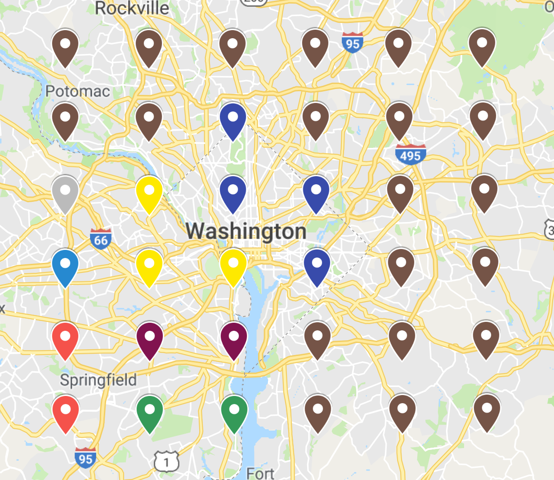
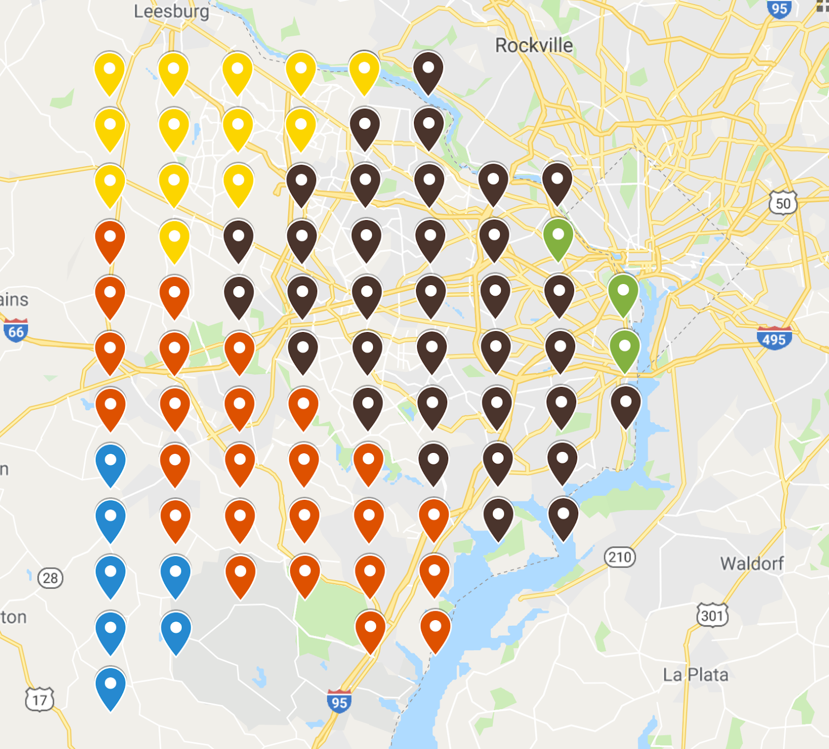
Regions

Slide 11
Times of Interest
30 Min Intervals
24 Hours a Day
5 Days a Week
240 Unique Times

Slide 12
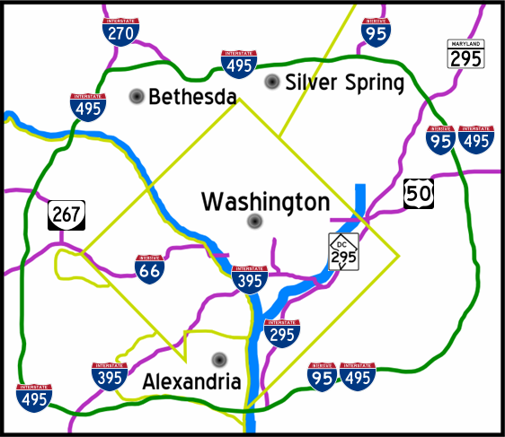
Paths of Interest
I-66 Corridor
66
29
50
GW Parkway
This Photo by Unknown Author is licensed under CC BY-SA

Slide 13
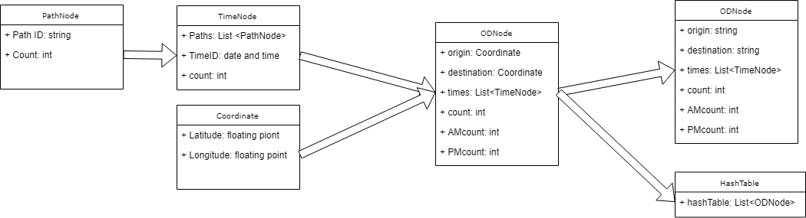
Data Structure
Store Raw Data in RAM
Flexible
Robust
Non Biased

Slide 14
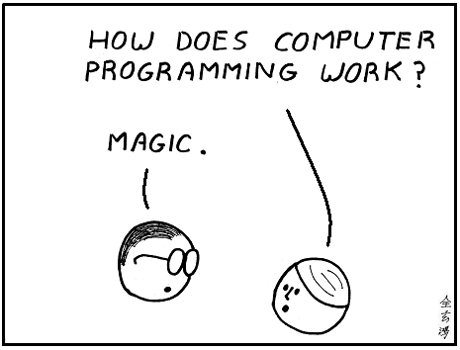
Program
System Used
Data Preparation
Analysis by Small Input
Aggregation
This Photo by Unknown Author is licensed under CC BY-NC

Slide 15

System Used
UVA High Performance Computer ”Rivanna”
Thousands of small computers (CPU)
Large data storage

Slide 16
Data Preparation
Take advance of Rivanna’s many CPUs
Analyze data simultaneously

Slide 17
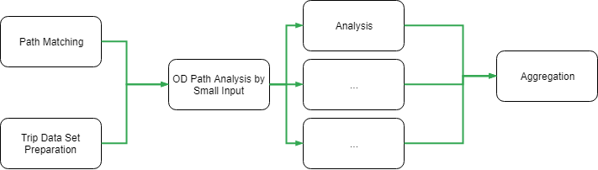
Analysis by Small Input
Time Filtering
OD Filtering
Time Mapping
Path Mapping

Slide 18
Aggregation

Slide 19
Findings
Statistical Test
Path Proportion Analysis

Slide 20
Statistical Test Used
Two Population Proportion Analysis

Slide 21
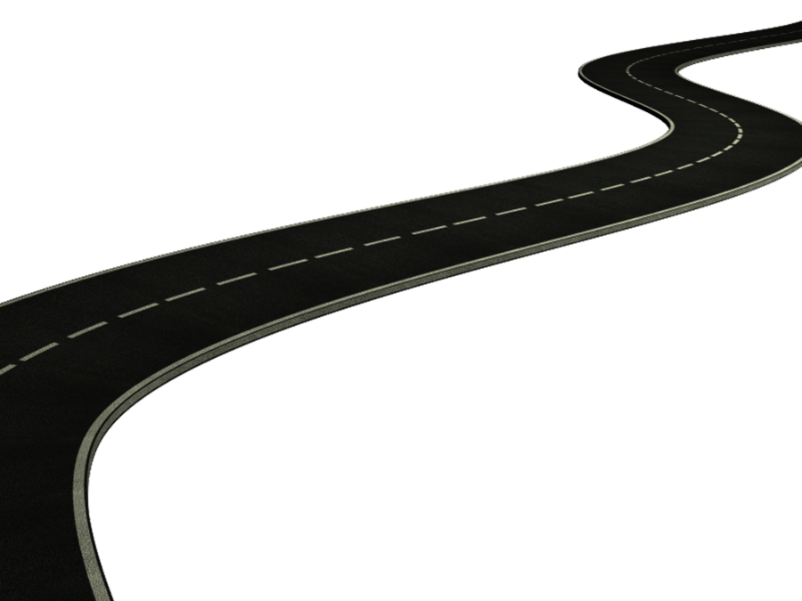
Path Proportion Analysis
Year to Year
Respect to OD Pair
Respect to OD Pair and Time
This Photo by Unknown Author is licensed under CC BY

Slide 22
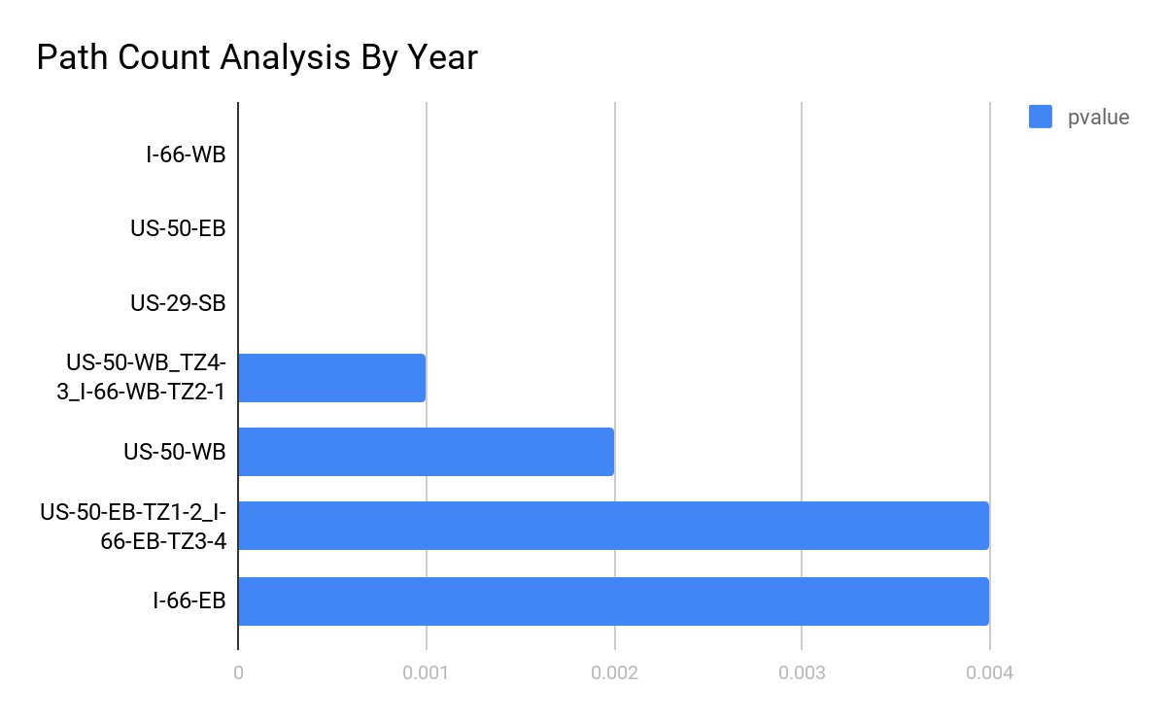
Year to Year
Null Hypothesis
Path had same proportion year to year

Slide 23
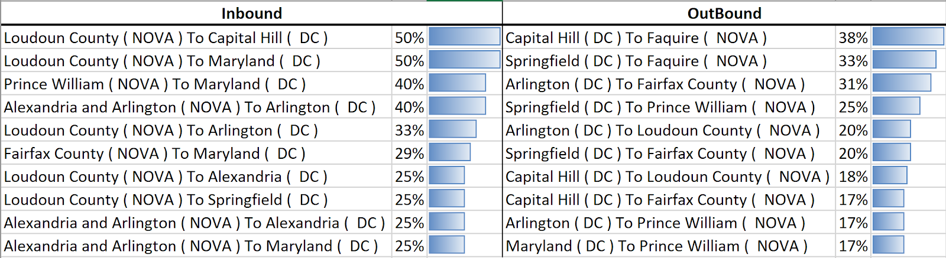
Relative to OD Pair
Heart of the study
More inbound change
Mix of distances

Slide 25
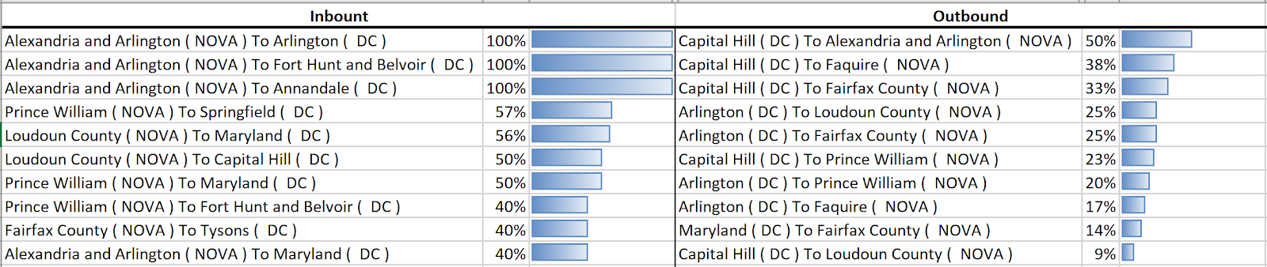
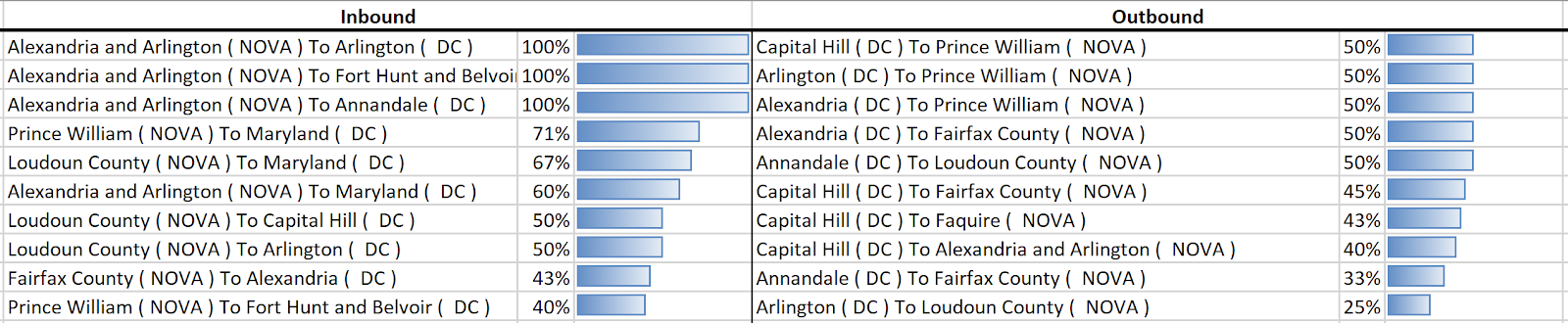
Relative to OD Pair and Time
AM = 0000-1200 PM = 1200-2400
AM = 0530-0930 PM = 1500-1900

Slide 26
Conclusion
Thoughts on Data Sets
Confidence in Results

Slide 27
Thank You

